Slide 1
Mall Navigation System
Project Guide : Ms.Dhanya
BCA GROUP 4
Anushka M | 19USCA01
Honey sunny | 19USCA21
Arun Augustin | 19USCA07
Department Of Computer Science
ST.JOSEPH’S COLLEGE ,DEVAGIRI

Slide 2
Index
Synopsis
Existing system
Disadvantages of existing system
Proposed system
Advantages of proposed system
Technologies used
Organizational profile
Hardware and software specifications
ER Diagram
DFD
Table Design
Input Output Forms.
Conclusion.

Slide 3
Introduction
The proposed system is used to navigate through shopping malls .A network of devices is used to give turn-by-turn directions to locations or objects where GPS and other technologies cannot work.
User can view offers,products,vacant spaces at the parking ,rate and feedback and car parking tracker are the other features of the system

Slide 4
Existing System
A proper dynamic system doesn’t exist.So people use
Building maps
Sign boards
Asking to others/security Guards

Slide 5
Disadvantages
Time consumption/Time wastage
Unreliable
Confused because of structure and complexity of malls
Lack of accuracy
Lack of availability of securities/mall staff

Slide 6
Proposed system
A navigation system that helps the customer locate themselves inside the mall and get to the desired shop or service using indoor mobile localization .
After current location is pinpointed the path to the destination is determined and is communicated to the user ,while giving live directions based on the change in the location of the user.

Slide 7
A voice assistant is provided for visually disabled users, the app can also set to be activated when the volume button is pressed thrice.
An alert of the offers in nearby shops will be given according to the location of the user

Slide 8
Advantages
Accurate and reliable
Low cost for implementation
Saves time
Assist visually impaired person
Improve customer satisfaction
Help in emergency situation
Proximity marketing
Boost revenue

Slide 9
Hardware Specification
RAM : 4GB and above
Processor : intel core i3 and above
Hard Disk : 320GB hard disk and above

Slide 10
Software Specification
Operating System : windows 10 or above
Front End : HTML,CSS,JS
Back End : MYSQL,PYTHON
Software Used: Jetbrains,PyCharm,Android studio

Slide 11
Regional technologies
REGIONAL TECHNOLOGIES is a rapidly growing company that provides professional IT services. We are one of the largest and Best software development companies in Kerala with focus on .Net, PHP, Java, Software testing, SEO and Web Design. As a leader in providing Offshore Software Development and related services, REGIONAL TECHNOLOGIES functions from an offshore set-up, based in Kerala, India. Our reputation enables us to serve in terms of Outsourced Software Development, Web Development, designing of website and their corresponding development. Particularly high end developments using Microsoft .NET, Java J2EE platforms, ASP, ASP.NET, PHP development as well as VB.6.0 Development adjoins us to a particularly niche sector of the global servicing. We have worked for and have provided services to the 6 of the top 10 Fortune 500 companies of the world. We aim to provide our clients with comprehensive, end-to-end technology solutions that give them an advantage over the competition. From building applications that increase your productivity, to internet-enabling your business for maximum profits.

Slide 12
Our mission is to continuously optimize our customers' business through our world-class solutions, services and products.We ensure the success of our company by constantly and consistently satisfying our customers, shareholders and employees. With Continuous research and development we aim to make available latest technology and concepts and tailored it to our valuable clients requirement and enable them to march on the path of success towards the leader
discussions on the phone as needed.

Slide 13
Module Description
There are total four modules :
Admin
Shopping Mall
Shop
User

Slide 14
Admin
In this module Admin is one who manages the entire working of the system. Following are the main functions that can be performed by the Admin :
View and verify shopping mall
View complaints and actions taken by the shop/shopping mall
View rating and feedback

Slide 15
Shopping Mall
The registered shopping mall can have the following functions :
View complaints and action taken by the shop
View rating and feedback
Add and manage rooms
View request
Add or manage hotspot
Allocate hotspot

Slide 16
Shop
Shops can have the following functions :
Add and manage products and offers
View complaints and sent replies
View rating and feedback
Requesting available rooms
View status of the room

Slide 17
User
The customers can have the following functions :
View product and offers
Rate and feedback
Sent complaint
Navigation
Parking
View complaints and replies
View vacant spaces for parking

Slide 18
DFD

Slide 19
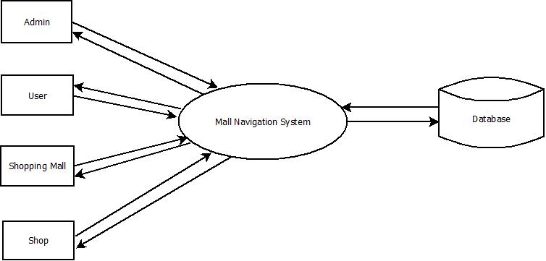
Level 0

Slide 20
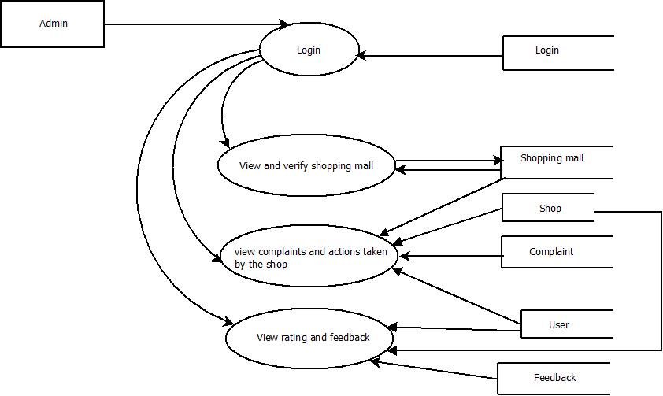
Level 1

Slide 21
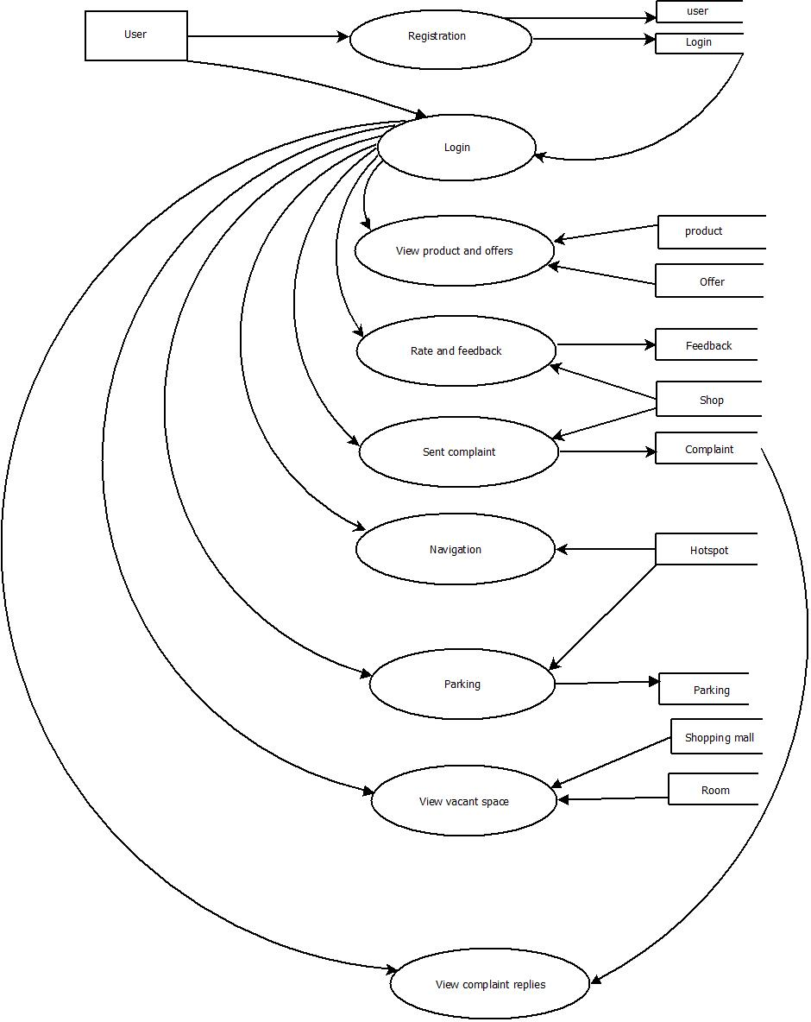
Level 2

Slide 22
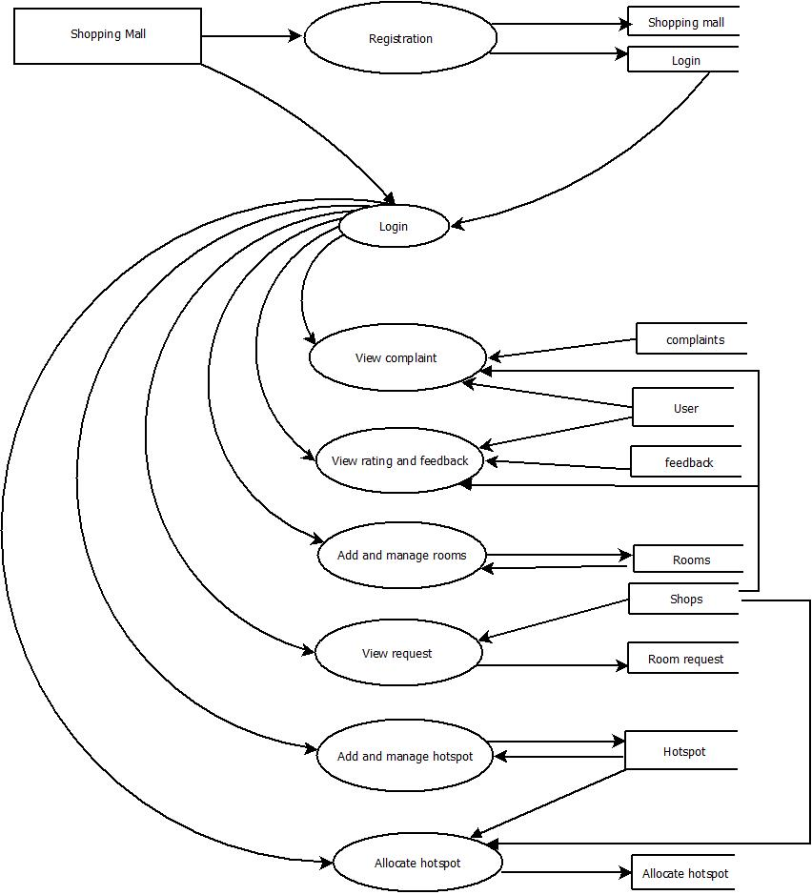
Level 3

Slide 23
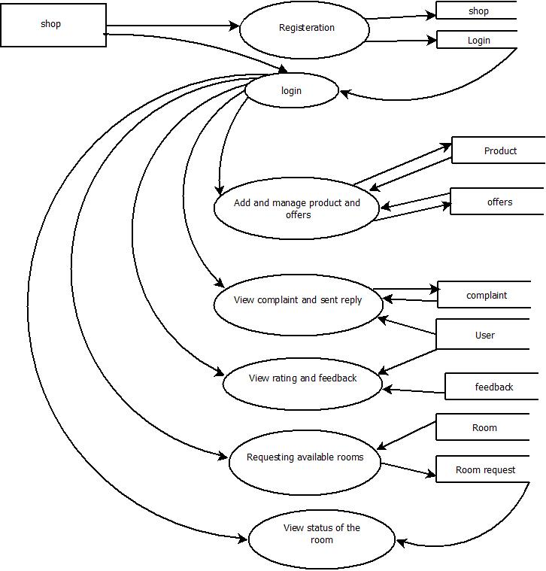
Level 4

Slide 24
ER DIAGRAM

Slide 25
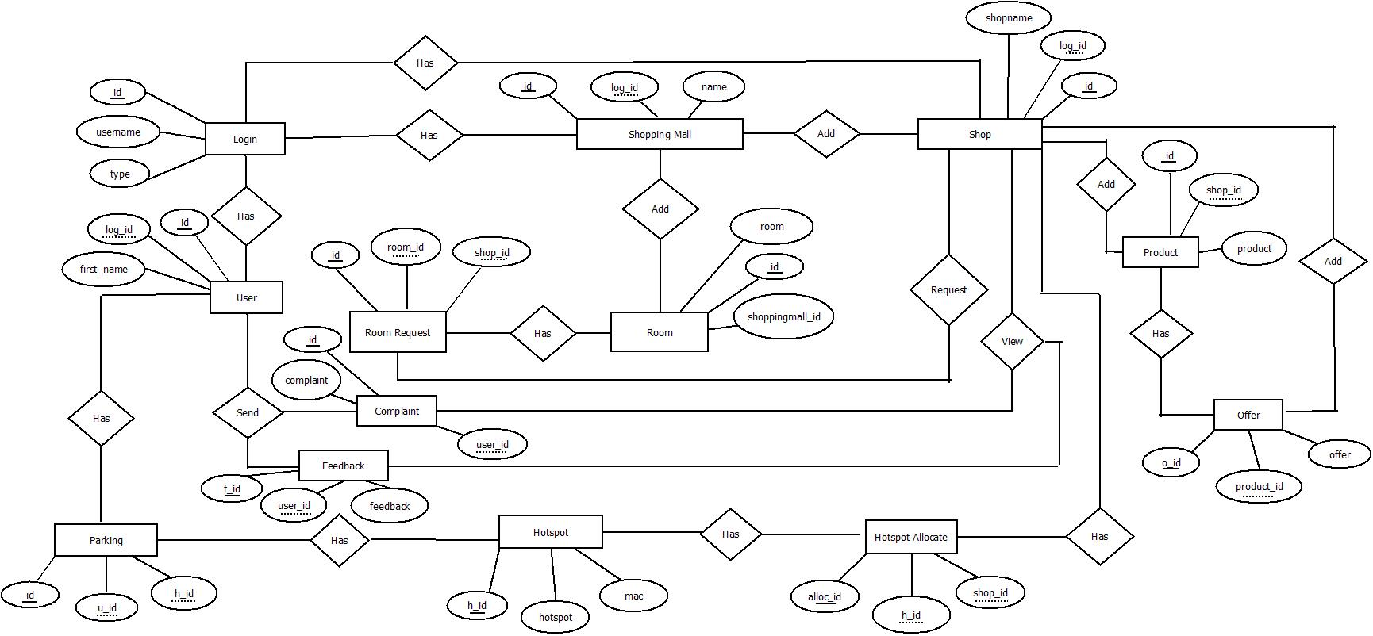

Slide 26
DATABASE DESIGN

Slide 27
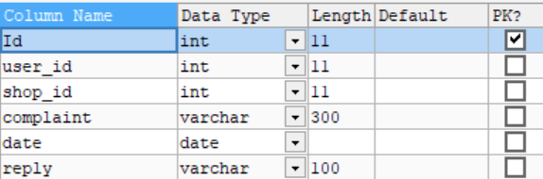
Complaints

Slide 28
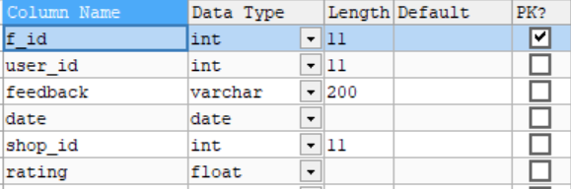
Feedback

Slide 29
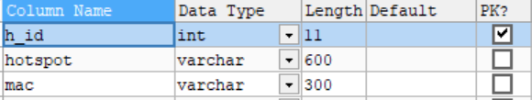
Hotspot

Slide 30
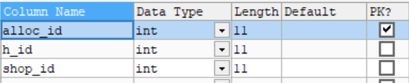
Hotspot allocation

Slide 31
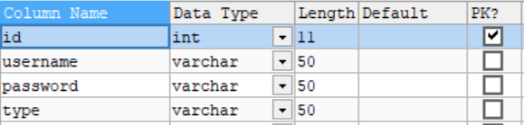
Login

Slide 32
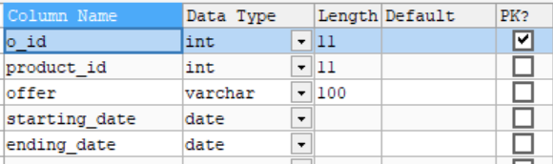
Offers

Slide 33
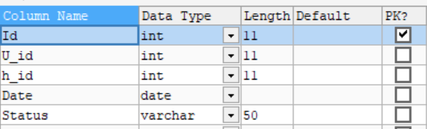
Parking

Slide 34
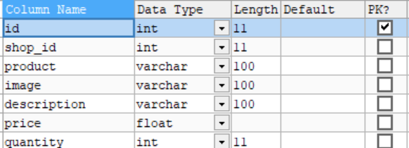
Product

Slide 35
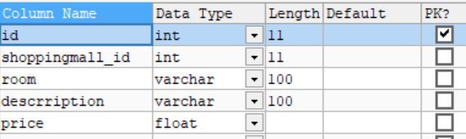
Room

Slide 36
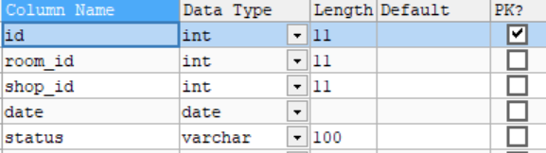
Room request

Slide 37
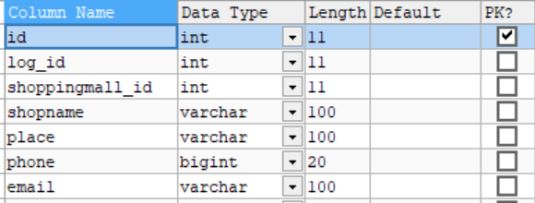
Shop

Slide 38
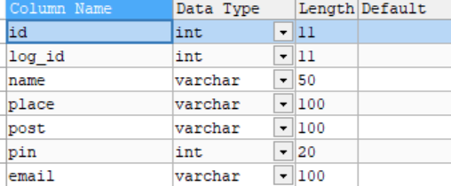
Shopping mall

Slide 39
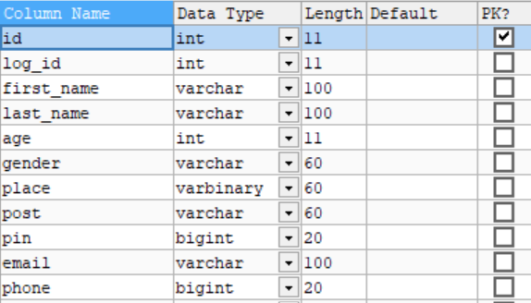
User

Slide 40
Input Form Design

Slide 41
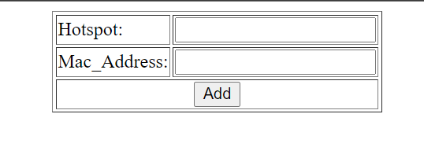
Add hotspot

Slide 42
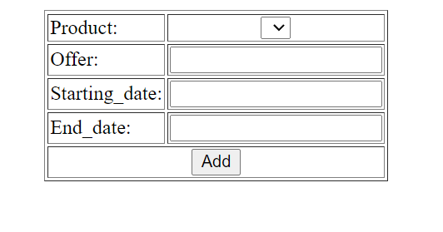
Add offers

Slide 43
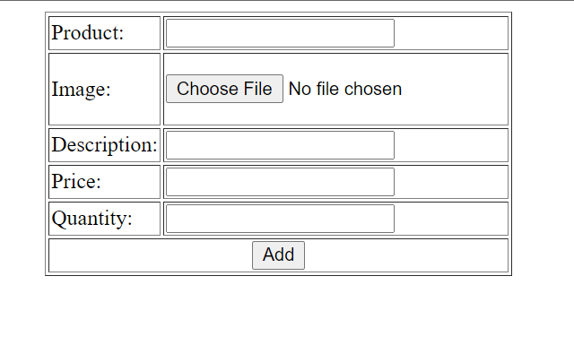
Add product

Slide 44
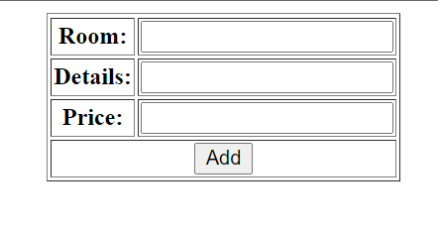
Add room

Slide 45
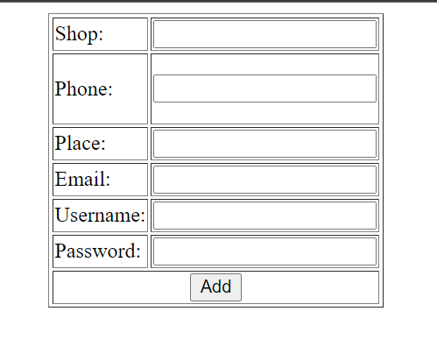
Add shop

Slide 46
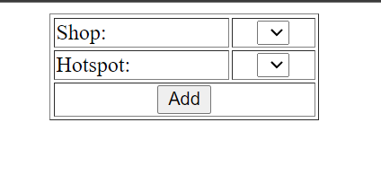
Allocate Hotspot

Slide 47
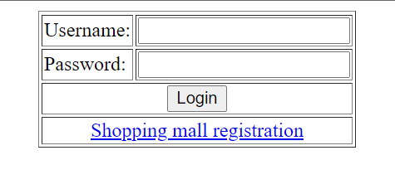
Login

Slide 48
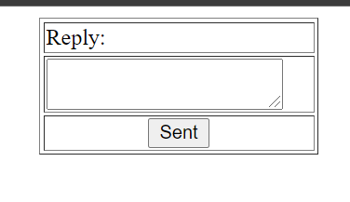
Send reply

Slide 49
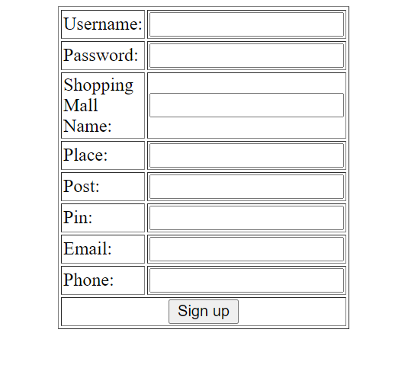
Shopping mall registration

Slide 50
Output Form Design

Slide 51
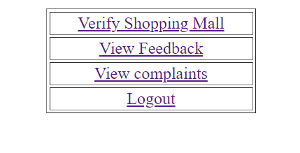
Admin home

Slide 52
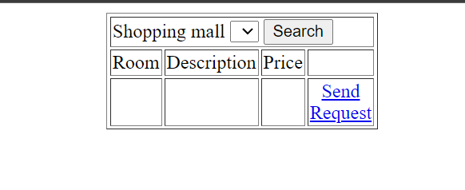
Available rooms

Slide 53
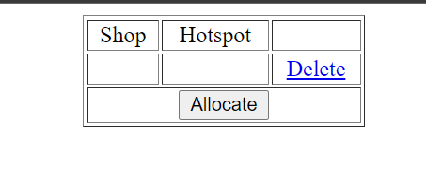
Manage allocated list

Slide 54
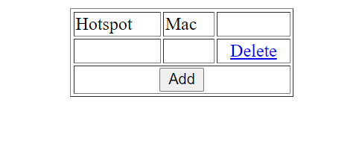
Manage hotspot

Slide 55
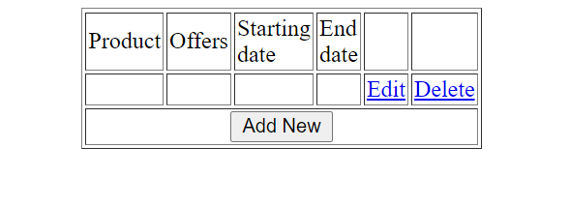
Manage offers

Slide 56
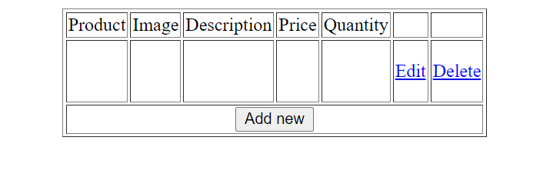
Manage product

Slide 57
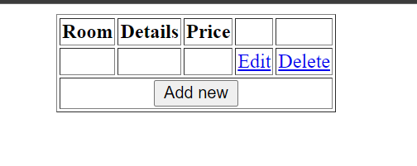
Manage rooms

Slide 58
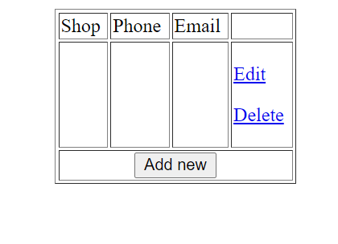
Manage shops

Slide 59
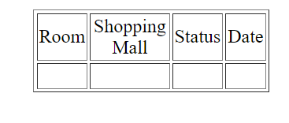
Request status

Slide 60
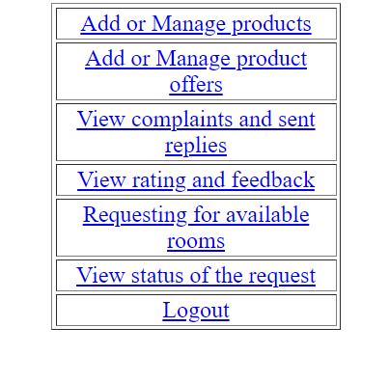
Shop home

Slide 61
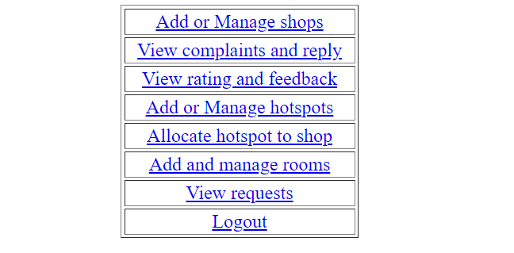
Shopping mall home

Slide 62
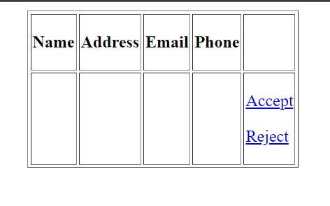
Verifying shopping mall

Slide 63
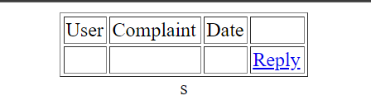
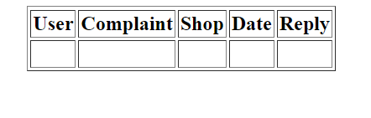
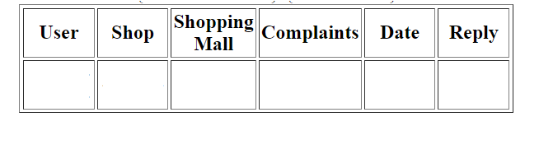
View complaints and replies

Slide 64
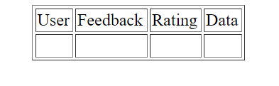
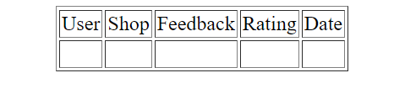
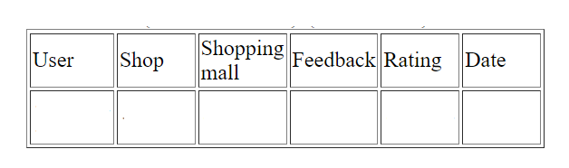
View feedback and rating

Slide 65
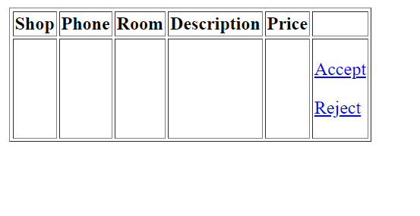
View request

Slide 66
Conclusion
We have build a website and two android applications.
website is used by admin ,shopping mall and shops.
Both android applications are used by the users.
one is mainly for navigation and other one provide various other functions.

Slide 67
Thank you!!

